Slide 1





Alaska State-wide
Literacy Screener
Statutory Requirement AS 14.30.760
June 2026
Notes:
Amplify: company/vendor that provides literacy products and services. Amplify licenses and delivers the assessment platform used by Alaska and many other states.
mCLASS,: assessment system and platform (digital provider) developed and managed by Amplify. It includes:
Assessment administration tools
Data collection and reporting
Progress monitoring
Dyslexia screening indicators
Instructional recommendations
Student and classroom reports
Benchmark and growth data
DIBELS 8th Edition is the actual assessment measure administered within the mCLASS platform.

Slide 2

Literacy Screener Components
Measure | Grade K | Grade 1 | Grade 2 | Grade 3 | Grade 4-5
Letter Naming Fluency | ✔ | ✔
Phonemic Segmentation Fluency | ✔ | ✔
Nonsense Word Fluency | ✔ | ✔ | ✔ | ✔
Word Reading Fluency | ✔ | ✔ | ✔ | ✔
Oral Reading Fluency |  | ✔ | ✔ | ✔ | ✔
Maze (Basic Comprehension) ** |  |  | ✔ | ✔ | ✔
Vocabulary** |  |  | ✔ | ✔
Rapid Automatized Naming (RAN) */** | ✔
Spelling * / ** |  | ✔ | ✔ | ✔
* Additional Assessment for students who score a Well Below Benchmark Composite Score
** Maze, Vocabulary and Spelling and RAN are assigned in the Online Assessment Manager
Notes:
DIBELS 8 consists of the literacy screening and progress-monitoring measures, including:
Letter Naming Fluency (LNF)
Phonemic Segmentation Fluency (PSF)
Nonsense Word Fluency (NWF)
Word Reading Fluency
Oral Reading Fluency (ORF)
Maze and other measures, depending on grade level
DIBELS was originally developed by researchers at the University of Oregon and is used nationally to measure foundational reading skills.

Slide 3

Headlines
Fewer Students are starting the year (each year) at Well Below Benchmark
88% of students who score at Benchmark at BOY remain At/above Benchmark at EOY
97% of students who score Above Benchmark at BOY remain At/above Benchmark at EOY
Progress monitoring usage has increased throughout the 25-26 school year.
Ongoing Professional Development offered to Alaska Educators and Leaders; Calibration Course enhancements based on user feedback
Note: BOY – Beginning of Year; EOY – End of Year

Slide 4
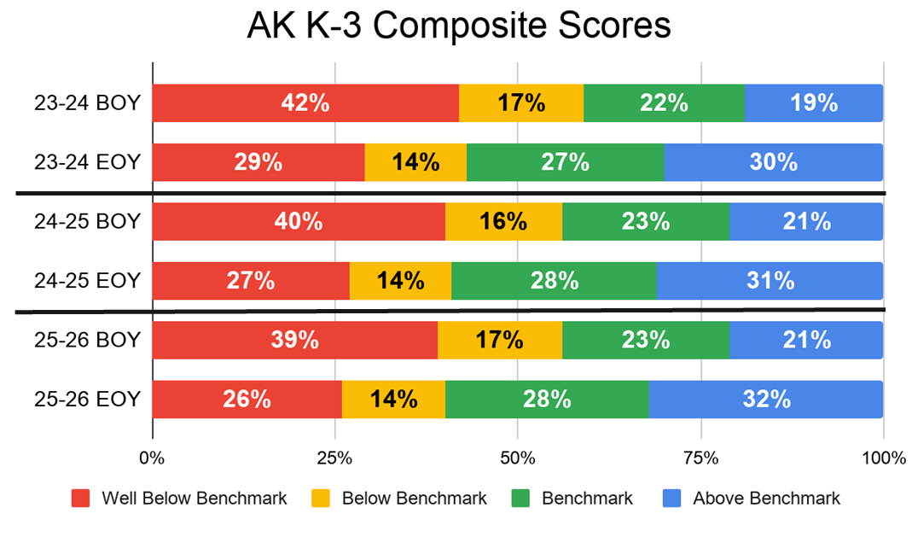

BOY- EOY Composite Scores 23-24 through 25-26

Slide 5
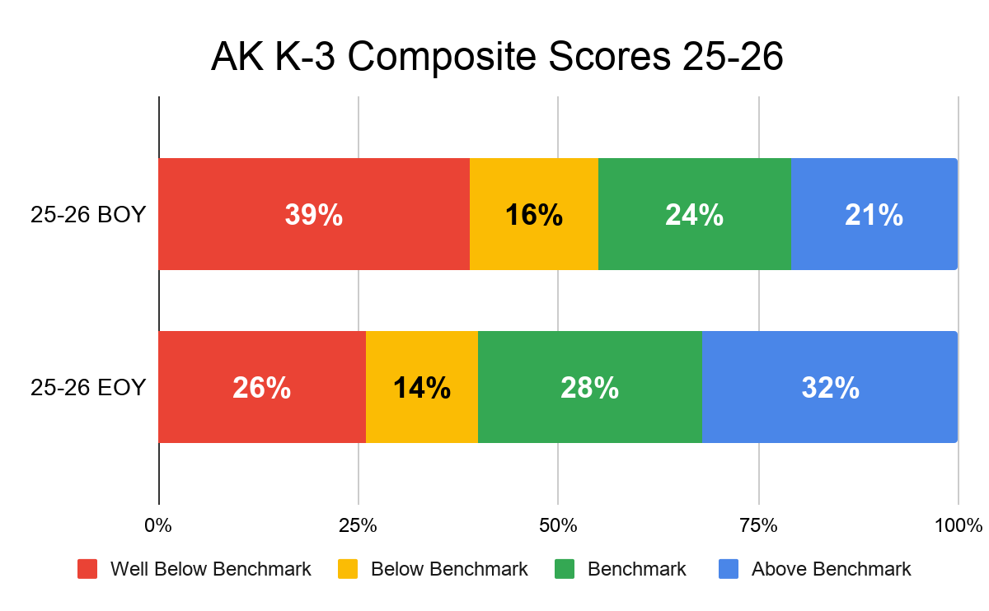
Alaska BOY- EOY K-3 Composite Scores 25-26
3,771 more students are at and above benchmark at EOY!thisar
4,264 fewer students are well below benchmark at EOY!

Slide 6
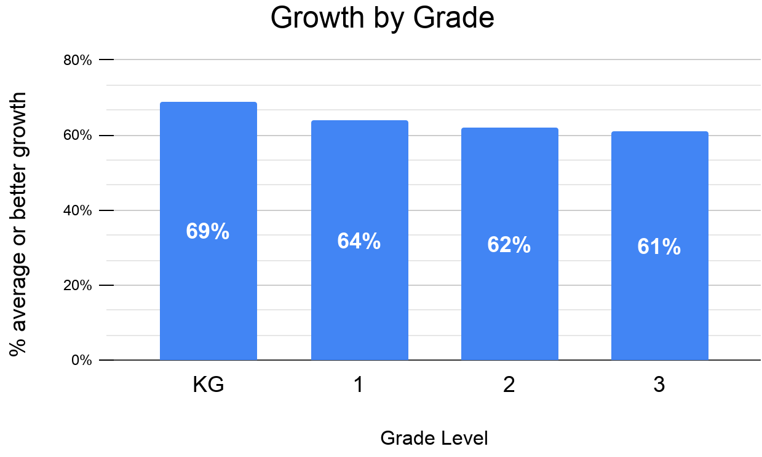
Alaska Growth BOY- EOY 25-26
Compared to National Norms
Alaska students are on track with peers nationwide making average or better growth on DIBELS 8 throughout the 25-26 SY.

Slide 7
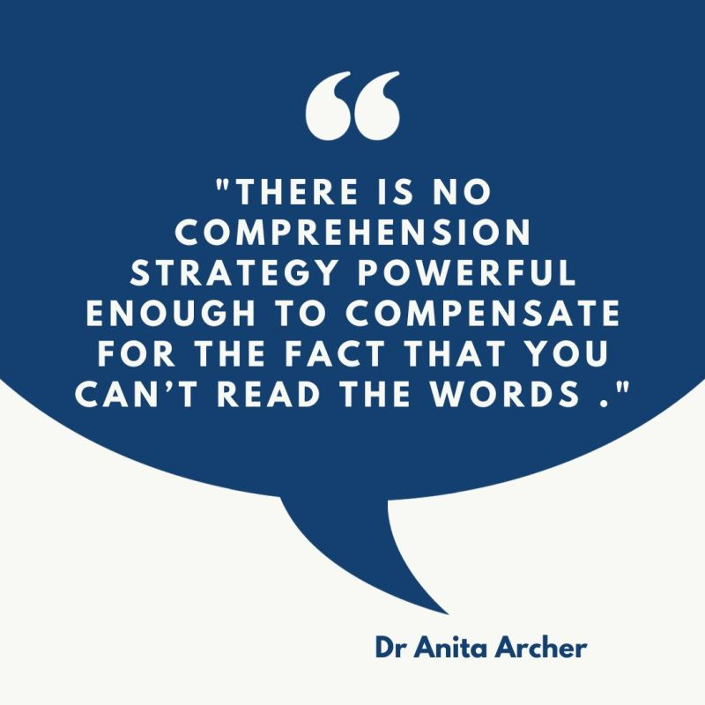
Questions?

